Slide 1
Review
AR(1)

Slide 2
AR(1) Models: Review
Realizations are wandering or oscillating depending on whether the root of the characteristic equation is positive or negative, respectively.
Autocorrelations are damped exponentials or damped oscillating exponentials depending on whether the root of the characteristic equation is positive or negative, respectively.
Spectral densities have a peak at f = 0 or f =.5 depending on whether the root of the characteristic equation is positive or negative, respectively.

Slide 4
Autoregressive Model of Order (Lag) 2

Slide 5


Autoregressive Model of Order 2: AR(2)
Notes:
This model “looks like” a multiple regression model with two independent variables.
But in this case, the “independent variables” are values of the dependent variable at the two previous time periods.
It specifies that the value at time t is a linear combination of values at the two previous time periods plus a random noise component that enters the model at time t.

Slide 7
AR(2) | Stationarity

Slide 8
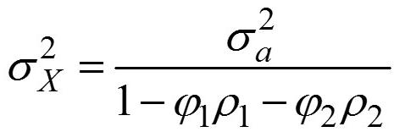


Facts about Stationary AR(2) Processes
Expected value
Variance
Autocorrelations and spectral density
The fundamental behavior of the autocorrelations and spectral density depends on whether the roots of the characteristic equation are real or complex.
Notes:
Consider renaming: AR(2) Expected Value and Zero Mean Form.

Slide 10
AR(2) | Zero Mean Form

Slide 11
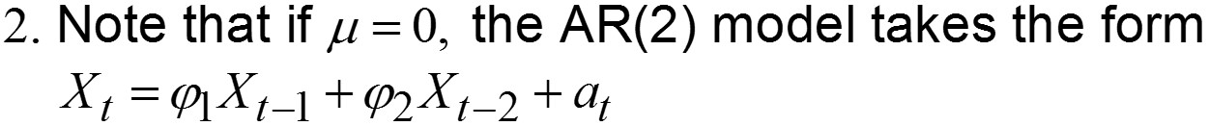
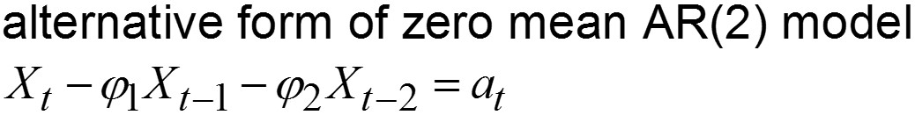
AR(2) Processes: Zero Mean Form
Zero mean form
as in the AR(1) case, this is called the “zero mean” form of the model and we sometimes use it for convenience
•

Slide 13
AR(2) | Backshift Operator

Slide 14





AR(2): Backshift Operator Notation
Backshift operator notation for AR(2)
Using this more general definition of the backshift operator, we can rewrite:
Notes:
Consider Renaming: AR(2) Backshift Operator Notation

Slide 16
AR(2) | Characteristic Equation and Stationarity

Slide 17
AR(2) Characteristic Equation and Stationarity
Light board
Define key result
Example:
X_{t} + .2X_{t-1} + .7X_{t-2} = a_{t}
X_{t} + .2BX_{t} + .7B²X_{t} = a_{t}
1 + .2z + .7z² = 0 be sure and define characteristic equation for AR(2) and so on

Slide 18
AR(2) Key Result about Stationarity
Key result
An AR(2) model is stationary if and only if the roots of the characteristic equation are greater than 1 in absolute value (lie outside the unit circle).

Slide 19
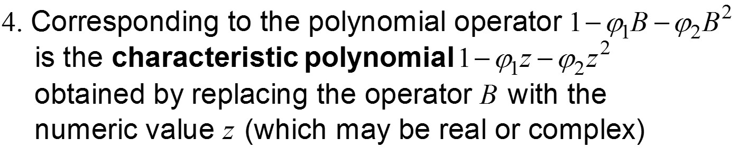
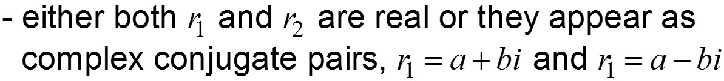
AR(2) Characteristic Polynomial and Equation
Light board?
Consider re-naming:
Characteristic polynomial and characteristic equation
Notes:
Go over this in detail will be good for Live Session! Give them a couple to work for live session to determine if they are stationary or not?

Slide 21
AR(2) | Real Roots

Slide 22



AR(2) Key Result about Stationarity
Key result
An AR(2) model is stationary if and only if the roots of the characteristic equation are greater than 1 in absolute value.
Are the following AR(2) models stationary?
Note: It is essentially impossible to tell by simple examination of the coefficients. We will use the key result above to make the determination.

Slide 23
Are These AR(2) Models Stationary?
What are the roots?
Both roots are >1 in absolute value,
so the model is stationary
Notes:
Lightboard

Slide 24
Are These AR(2) Models Stationary?
What are the roots?
Since r₁ = .67 < 1 in absolute value,
the model is not stationary
Notes:
Lightboard

Slide 26
AR(2) | Imaginary Roots

Slide 27
Light board on imaginary roots and quadratic formula
With full example

Slide 29
AR(2) | Example with Imaginary Roots

Slide 30

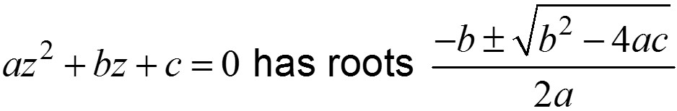
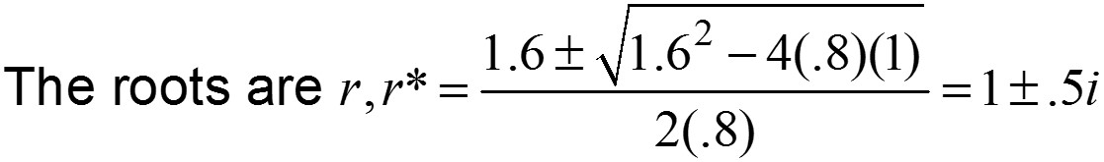

Are These AR(2) Models Stationary?
ICC
What are the roots?
This quadratic can’t be factored as in the other two cases, so we use the quadratic formula:
Modulus
Since | r | > 1 the model is stationary
Notes:
Lightboard

Slide 32
AR(2) | Two Real Roots

Slide 33




Case 1: Characteristic Equation for AR(2) Model Has Two Real Roots
stationary with two real roots
Characteristic equation:
Factored form
Note: The operator form
To understand the behavior of the AR(2) model above, we first consider the two AR(1) models associated with the two first order factors

Slide 34

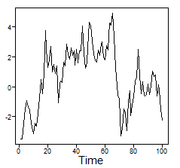
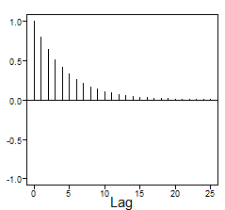
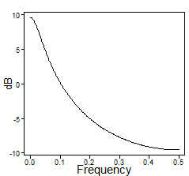


Realization from model above
Autocorrelations
Spectral density

Slide 35

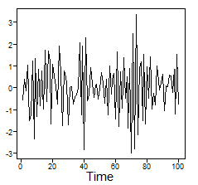
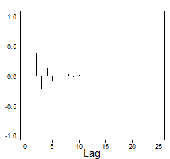
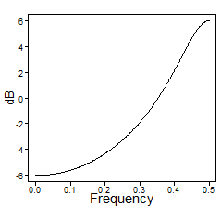
Realization from model above
Autocorrelations
Spectral density

Slide 36
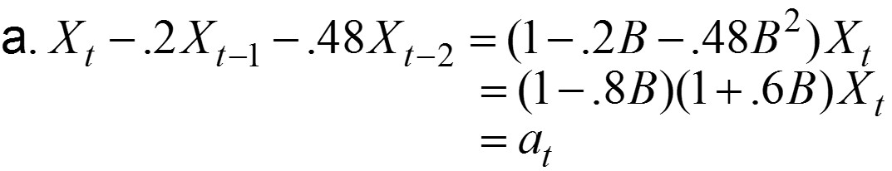
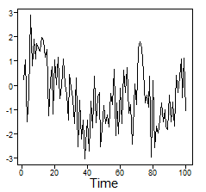
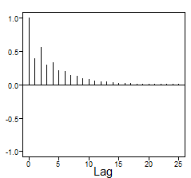
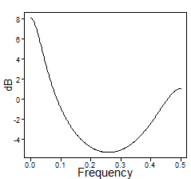
Returning to Stationary AR(2) Model with Two Real Roots (One Positive and One Negative)
Realization from model above
Autocorrelations
Spectral density
Wandering (due to 1 − .8B) and high-frequency behavior (due to 1 + .6Β)
Damped exponential (due to 1 − .8B) with a hint of oscillatory behavior for small lags (due to 1 + .6Β)
Very easy to see peak at zero (due to 1 − .8B) and peak at .5 (due to 1 + .6B)

Slide 37
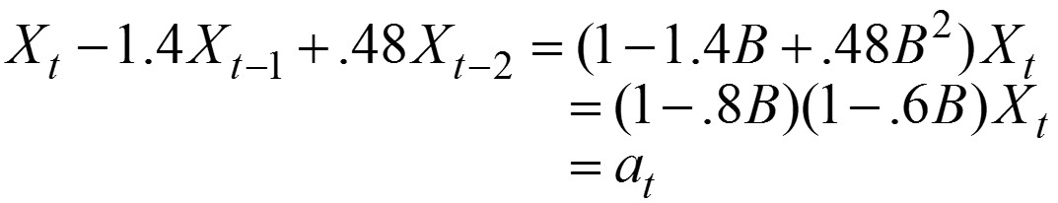
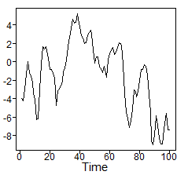
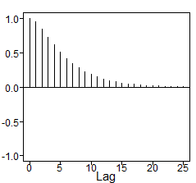
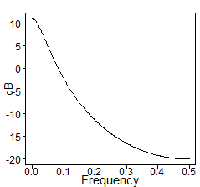
Stationary AR(2) Model with Two Positive Real Roots
Realization from model above
Autocorrelations
Spectral density
Notice that this model has two positive real roots. We see that the behaviors of all three plots are similar to those for the AR(1) model, (1 − .8B)X_{t} , which had one real root.

Slide 39
AR(2) | tswge
Two Real Roots

Slide 40
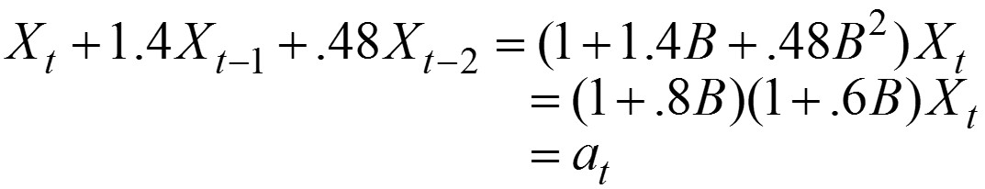
Stationary AR(2) Model with Two Negative Real Roots
Notice that this model has two negative real roots. Behaviors of the plots (realization, autocorrelations, and spectral density) are similar to those for AR(1) models with a negative real root.
Try it.
With tswge?
Notes:
!!! TRY IT IN tswge? SCREEN SHARE?

Slide 42
AR(2) | Complex Conjugate Roots

Slide 43

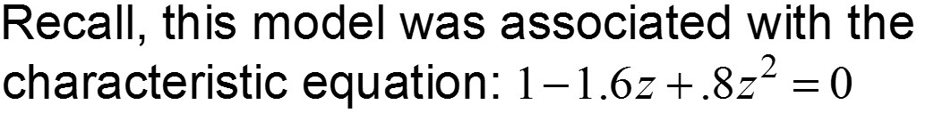
Case 2: Stationary AR(2) Model with a Pair of Complex Conjugate Roots
Recall the stationary AR(2) model.
that are greater than one in absolute value.

Slide 44
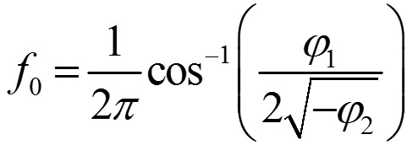
Stationary AR(2) Model with a Pair of Complex Conjugate Roots
Key facts
A stationary AR(2) model, (1 − ϕ₁Β − ϕ₁Β ²)X_{t} = a_{t}, whose characteristic equation has complex conjugate roots, has an autocorrelation function that has the appearance of a damped sinusoidal curve.
This sinusoidal function has frequency f₀, where

Slide 45
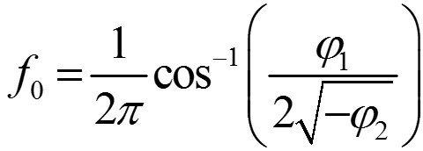
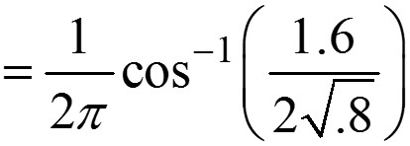
Stationary AR(2) Model with a Pair of Complex Conjugate Roots
Returning to the AR(2) model
(Again, be careful about the signs)
So,
=.0738

Slide 46
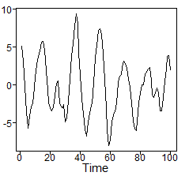
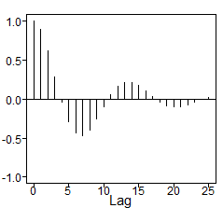
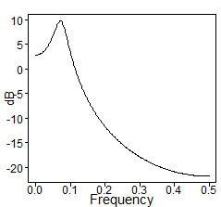
Stationary AR(2) Model with a Pair of Complex Conjugate Roots
Realization from model above
Autocorrelations
Spectral density
The realization is pseudo-cyclic with about 7 cycles in the series of length 100. That is, the cycle length is about 100/7 ≈ 14.
Autocorrelations have a damped sinusoidal behavior with cycle length about 13 or 14, which is consistent with f₀ = .0738.
Spectral density has a peak at about .07 ≈ f₀.

Slide 47
Stationary AR(2) Model with a Pair of Complex Conjugate Roots
Summarizing: A stationary AR(2) model, (1 − ϕ₁Β − ϕ₁Β ²)X_{t} = a_{t}, whose characteristic equation has complex conjugate roots
Has realizations that show a pseudo-cyclic behavior with cycle length about 1/f₀, where f₀ is given on previous slides
The autocorrelation function has the appearance of a damped sinusoidal with frequency f₀ (i.e., cycle length 1/f₀ )
The spectral density has a peak at about f₀
Notes:
HUGE!!! Assign a model with complex roots to be prepared in a powerpoint presentation for Live Session. They should find the roots, the modulus, make a decision about stationarity, find the frequency by hand, and use tswge to plot a realization and look at the spectral density of the model and of the realization.

Slide 49
AR(2) | Example
Canadian Lynx Data

Slide 50
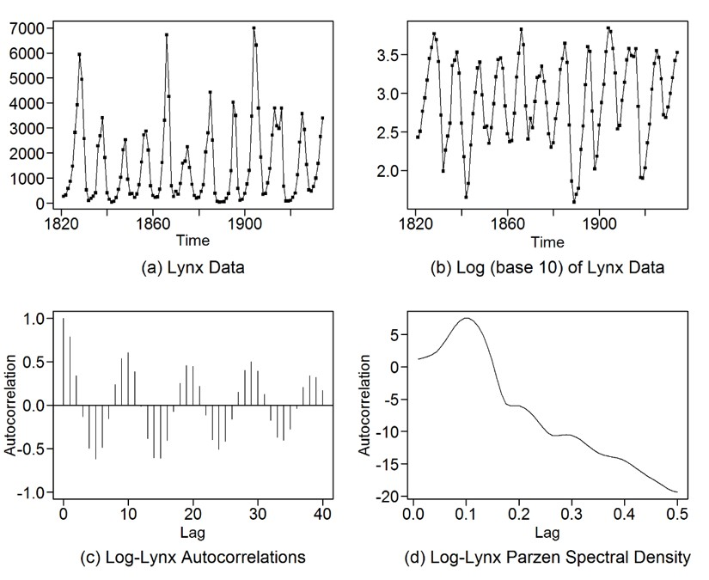
Canadian Lynx Data
Lynx data
Log(base 10) lynx data
Year
Year
Classic data set used by time series analysts
Data are the number of Canadian lynx trapped in the Mackenzie River district of Northwest Canada from 1821–1934 (above left)
Data show a somewhat surprising 10–11 year cycle
Due to the asymmetric behavior of the cycles, it is common to analyze the “log-lynx” data (above right)

Slide 51
Lynx Data
Log lynx data
Autocorrelations
Spectral density
Year
Lag
Frequency
Notes: The above plots are typical of those produced by AR(2) models for which the characteristic equation has complex conjugate roots.
The log lynx data have a pseudo-cyclic appearance.
The autocorrelations show damped sinusoidal behavior.
The spectral density has a peak at some f₀ between 0 and .5 (at approximately .1 in this case).

Slide 52

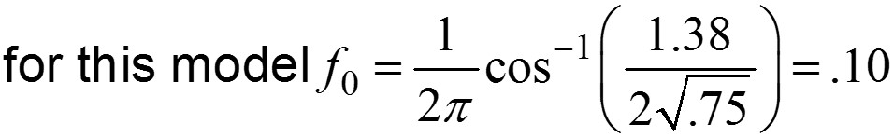
Lynx Data
If an AR(2) model is fit to the log lynx data using standard techniques (to be discussed later), we obtain the fitted model
Notes about this model:
The mean of the log lynx data is 2.9
The characteristic equation 1 − 1.38z + .75z² = 0 has complex conjugate roots greater than 1 in absolute value
•

Slide 54
AR(p) | Properties and Characteristic Equation

Slide 55

Autoregressive Model of Order p: AR(p)
We are now ready to define the general AR(p) model, where p is any positive integer.
where
“Looks like” a multiple regression model
Says the value at time t is a linear combination of the p previous values plus a random noise component a_{t}
Looks “complicated”

Slide 56


Autoregressive Model of Order p: AR(p)
Zero mean forms
or
Operator form: zero mean
or
AR(p): characteristic equation

Slide 58
AR(p) | Key Result about the Characteristic Equation

Slide 59
Key Result for AR(p)
An AR(p) model is stationary if and only if the roots of the characteristic equation are greater than 1 in absolute value.
Note: This is a generalization of the check for stationarity given earlier for AR(1) and AR(2) models.
for AR(2) this check is still easy, but you may have to factor the polynomial or use the quadratic formula to find the roots
for AR(p), p > 2 the check is more complicated

Slide 60
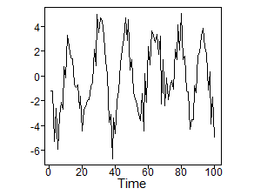
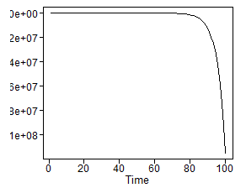
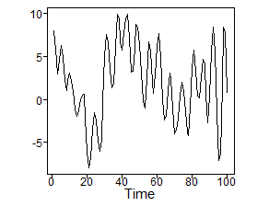
Consider the Following AR(p) Models
X_{t} – 1.95 X_{t–1} + 1.85X_{t–2} – .855 X_{t –3} = a_{t}
X_{t} – .2 X_{t–1} – 1.23 X_{t–2} + .26 X_{t–3} + .66 X_{t–4} = a_{t}
X_{t} – X_{t–1} – .5X_{t–2} + .8 X_{t–3} – .7X_{t–4} = a_{t}
Can you match models with realizations below (shown in random order)?

Slide 61
That’s Really a Tough Assignment
I’m guessing you can’t match models with realizations?
Good new
I can’t either.
Bad news
It seems like AR(p) models may be too complicated (and nearly impossible) to understand.
Good news
There’s a simple way to understand these models using a key concept that we will work towards now and will present in the next section!

Slide 62
Factoring the AR(p)
Note: The roots of a general pth order polynomial equation cannot always be found using mathematical formulas (such as the quadratic formula).
But such polynomial equations can be solved using numerical methods.
The roots of ϕ (z) = 1 − ϕ₁z − ⋅ ⋅ ⋅ − ϕ_{p}z^{p} = 0 are of two types:
Real roots
Complex conjugate pairs (a + bi, a − bi)
Correspondingly, 1 − ϕ₁z − ⋅ ⋅ ⋅ − ϕ_{p}z^{p} can always be factored as a product of:
First-order (linear) factors
Second-order (quadratic) factors

Slide 63
Example 1
AR(3) model
1 − 1.95B + 1.85B² − .855B³ = a_{t}
Characteristic equation
1 − 1.95z + 1.85z² − .855z³ = 0
Factored characteristic equation
Linear factor
(1 − .95z) (1 − z + .9z²) = 0
Quadratic factor
Note: We often write AR models in factored form (analogous to the characteristic equation factoring).
Factored form of model
(1 − .95B) (1 − B+ .9B²) = a_{t}

Slide 64


Example 2: Two 4th-Order Polynomials
Factored forms
Linear factors
Quadratic factor
No linear factors
Quadratic factors
Key point: All polynomials can be factored into a product of first and second order factors.

Slide 66
AR(p) | Factor Tables

Slide 67
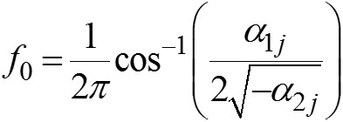
Key Concept
Factors like (1 − α₁B) and (1 − α₁B − α₂B²) serve as building blocks of an AR(p) model.
First-order factors, (1 − α₁B)
Associated with real roots
Contribute AR(1)-type behavior to the AR(p) model
Are associated with “system frequency” f₀ = 0 if α is positive and f₀ = .5 if α is negative
Second-order (quadratic) factors, (1 − α₁B − α₂ B²)
Associated with complex roots
Contribute cyclic AR(2)-type behavior to the AR(p) model, associated with “system frequency”

Slide 68
Key Concept
Factors like (1 − α₁B) and (1 − α₁B − α₂B²) serve as building blocks of an AR(p) model.
AR(p) models reflect a mixture of these first- and second-order behaviors in the:
Realizations
Autocorrelations
Spectral densities

Slide 69
Factor Table
A tabular presentation of an AR(p) model that:
Shows the underlying first- and second-order factors
Provides information about the roots of the characteristic equation to assess whether the model is stationary
Gives information concerning the underlying frequency domain characteristics
The format of the factor table is given on the next slide

Slide 70
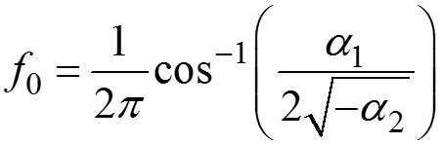
Factor Table
Absolute Reciprocal of root
System frequency (f₀)
Factor
Root
First- or second-order factor: (1 − α₁B) or (1 − α₁B − α₂B²)
Root(s) of first- or second-order equations associated with factor: 1 − α₁z = 0 1 − α₁z − α₂z² = 0
|r|⁻¹, where r is the root in second column
First-order factors: f₀ = 0, if α₁ > 0 f₀ = .5, if α₁ < 0
Second-order:
Note: If |r|⁻¹ < 1 for all roots, then the process is stationary.

Slide 71
X_{t} – 1.95X_{t – 1} + 1.85X_{t –2} – .855X_{t –3} = a_{t}
Is this a stationary process?
What are its characteristics?
The factor table helps answer these questions.

Slide 72
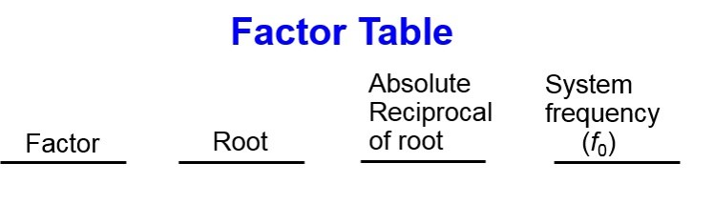
X_{t} – 1.95X_{t – 1} + 1.85X_{t –2} – .855X_{t –3} = a_{t}
1 − .95Β
1.053
0.95
0.0
1 − Β + .9Β ²
.556 ± .896i
0.95
0.16
What does the factor table tell us?
The model is stationary.
It is not immediately obvious whether .556 + .896i is greater than 1 in absolute value, so we show the absolute value
(we choose to show absolute value of the reciprocal, |r|⁻¹).
|r|⁻¹ < 1 for all roots implies stationarity.

Slide 73
X_{t} – 1.95X_{t – 1} + 1.85X_{t –2} – .855X_{t –3} = a_{t}
1 − .95Β
1.053
0.95
0.0
1 − Β + .9Β ²
.556 ± .896i
0.95
0.16
What does the factor table tell us?
The model has one positive real root
and a pair of complex conjugate roots.

Slide 74
X_{t} – 1.95X_{t – 1} + 1.85X_{t –2} – .855X_{t –3} = a_{t}
1 − .95Β
1.053
0.95
0.0
1 − Β + .9Β ²
.556 ± .896i
0.95
0.16
What does the factor table tell us?
The positive real root will be associated with:
“Wandering” behavior in realizations
Damped exponential autocorrelations
A peak at zero in the spectral density

Slide 75
X_{t} – 1.95X_{t – 1} + 1.85X_{t –2} – .855X_{t –3} = a_{t}
1 − .95Β
1.053
0.95
0.0
1 − Β + .9Β ²
.556 ± .896i
0.95
0.16
What does the factor table tell us?
The complex conjugate roots will be associated with:
Pseudo cyclic behavior in the realizations with frequency about f₀ = .16 (cycle length (1/.16 = 6)
Damped sinusoidal autocorrelations with a period (cycle length) of about 6
A peak at about .16 in the spectral density

Slide 76
X_{t} – 1.95X_{t – 1} + 1.85X_{t –2} – .855X_{t –3} = a_{t}
1 − .95Β
1.053
0.95
0.0
1 − Β + .9Β ²
.556 ± .896i
0.95
0.16
What does the factor table tell us?
For the above AR(3) model:
Realizations
Autocorrelations
Spectral density
will show a “mixture” of these behaviors

Slide 77
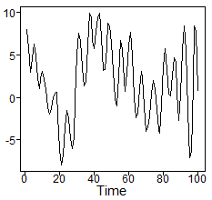
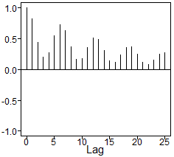
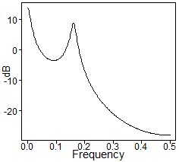
X_{t} – 1.95X_{t – 1} + 1.85X_{t –2} – .855X_{t –3} = a_{t}
1 − .95Β
1.053
0.95
0.0
1 − Β + .9Β ²
.556 ± .896i
0.95
0.16
What does the factor table tell us?
Realization
Autocorrelations
Spectral density

Slide 79
AR(p) | Factor Table in tswge

Slide 80
Factor Tables in tswge
tswge demo
#Factor Table
factor.wge(phi=c(1.95,-1.85,.855))
#
#Plotting a realization along with true
# autocorrelations and spectral density
plotts.true.wge(phi=c(1.95,-1.85,.855))

Slide 82
AR(p) | Examples

Slide 83



X_{t} – 1.95X_{t–1} + 1.85X_{t–2} – .855X_{t–3} = a_{t}
X_{t} – .2X_{t–1} – 1.23X_{t–2} + .26X_{t–3} + .66X_{t–4} = a_{t}
X_{t} – X_{t–1} – .5X_{t–2} + .8X_{t–3} – .7X_{t–4} = a_{t}
Can you match models with realizations below (shown in random order)?

Slide 84



X_{t} – 1.95X_{t – 1} + 1.85X_{t –2} – .855X_{t –3} = a_{t}
1 − .95Β
1.053
0.95
0.0
1 − Β + .9Β ²
.556 ± .896i
0.95
0.16
What does the factor table tell us?
Realization
Autocorrelations
Spectral density

Slide 85



Consider the Following AR(p) Models
X_{t} – 1.95X_{t–1} + 1.85X_{t–2} – .855X_{t–3} = a_{t}
X_{t} – .2X_{t–1} – 1.23X_{t–2} + .26X_{t–3} + .66X_{t–4} = a_{t}
X_{t} – X_{t–1} – .5X_{t–2} + .8X_{t–3} – .7X_{t–4} = a_{t}
Can you match models with realizations below (shown in random order)?

Slide 86
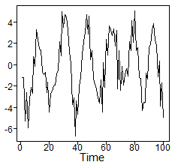
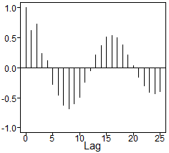
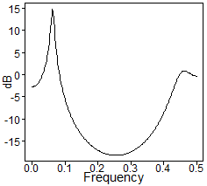
(B) X_{t} – .2X_{t–1} – 1.23X_{t–2} + .26X_{t–3} + .66X_{t–4} = a_{t}
1 − 1.8Β + .95Β ²
.95 ± 39i
0.97
0.06
1 + 1.6Β + .7Β ²
–1.15 ± 35i
0.83
0.45
Realization
Autocorrelations
Spectral density

Slide 87



Consider the Following AR(p) Models
X_{t} – 1.95X_{t–1} + 1.85X_{t–2} – .855X_{t–3} = a_{t}
X_{t} – .2X_{t–1} – 1.23X_{t–2} + .26X_{t–3} + .66X_{t–4} = a_{t}
X_{t} – X_{t–1} – .5X_{t–2} + .8X_{t–3} – .7X_{t–4} = a_{t}
Can you match models with realizations below (shown in random order)?

Slide 88
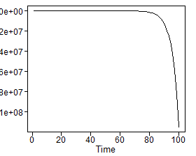
(C) X_{t} – X_{t–1} – .5X_{t–2} + .8X_{t–3} – .7X_{t–4} = a_{t}
1 − 1.25Β
.90
1.25
0.0
1 + Β
–1.0
1.00
0.5
1 −.75Β + .56Β ²
.67 ± 1.15i
0.75
0.17
Realization
Explosively nonstationary

Slide 89



Consider the Following AR(p) Models
(A) X_{t} – 1.95X_{t–1} + 1.85X_{t–2} – .855X_{t–3} = a_{t}
(B) X_{t} – .2X_{t–1} – 1.23X_{t–2} + .26X_{t–3} + .66X_{t–4} = a_{t}
(C) X_{t} – X_{t–1} – .5X_{t–2} + .8X_{t–3} – .7X_{t–4} = a_{t}
Can you match models with realizations below (shown in random order)?
(B)
(C)
(A)
Key point
The coefficients alone are not helpful in understanding the nature of AR(p) models.
Use factor tables.

Slide 91
AR(p) | Roots and Dominant Behavior

Slide 92
Key Fact
Roots close to the unit circle dominate.
To illustrate this we consider the three models:
Model A (in factored form)
Model A-r
Model A-c

Slide 93
To understand these 3 models we examine the factor tables (of course).
1 − .95Β
1.053
0.95
0.0
Model A
.56 ± .90i
0.95
0.16
1 − Β + .9Β ²
1 − .95Β
1.053
0.95
0.0
Model A-r
0.70
0.16
1 − .76Β + .5Β ²
.76 ± 1.19i
1 − .7Β
1.43
0.70
0.0
Model A-c
0.95
0.16
1 − Β + .9Β ²
.56 ± .90i
All three models have a first- and second-order factor
All three models have system frequencies of 0 and .16
Model A: roots equally close to the unit circle
Model A-r: real root closer to the unit circle than complex roots
Model A-c: complex root closer to the unit circle than real root

Slide 94
X _{t} – 1.95 X_{t – 1} + 1.85X_{t – 2} – .855 X_{t –3} = a_{t}
1 − .95Β
1.053
0.95
0.0
1 −Β + .9Β ²
.556 ± .896i
0.95
0.16
What does the factor table tell us?
Realization
Autocorrelations
Spectral density

Slide 95
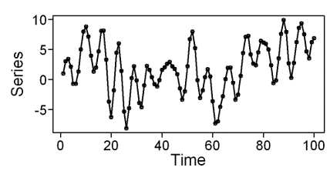
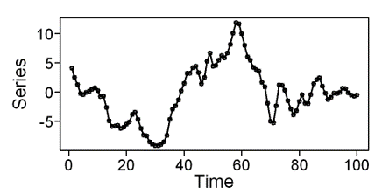
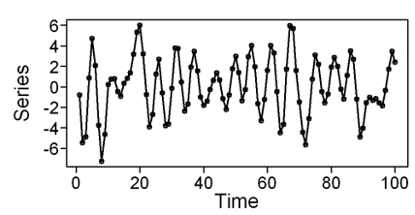
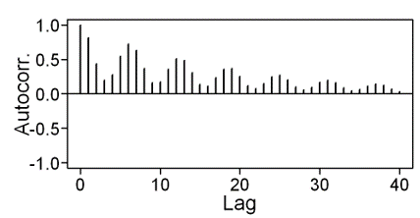
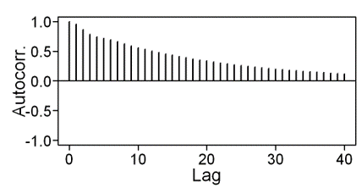
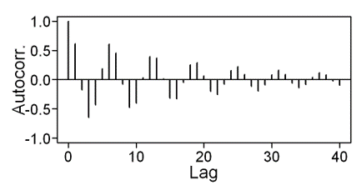



Model A
Model A-r
Model A-c

Slide 96
Notes
When roots were equally close to the unit circle, we saw both first- and second-order behaviors.
When the positive real root was closest to the unit circle, the first-order behavior dominated.
We barely see any evidence of a second-order factor.
When complex roots are closer to the unit circle, second-order behavior dominates.
We barely see any evidence of a first-order factor.
Takeaway
Roots closest to the unit circle dominate the behavior of autocorrelation functions, realizations, and spectral densities.

Slide 98
Review
AR(1) and AR(2)

Slide 99
AR(1) Models: Review
Realizations are wandering or oscillating depending on whether the root of the characteristic equation is positive or negative, respectively.
Autocorrelations are damped exponentials or damped oscillating exponentials depending on whether the root of the characteristic equation is positive or negative, respectively.
Spectral densities have a peak at f = 0 or f =.5 depending on whether the root of the characteristic equation is positive or negative, respectively.

Slide 100
AR(2) Models: Review
Real roots
If both are positive, then behavior is similar to that of an AR(1) with a positive real root.
If both are negative, then behavior is similar to that of an AR(1) with a negative real root.
If both positive and negative real roots, then both behaviors mentioned above tend to be visible.
Complex conjugate roots
Realizations are pseudo-cyclic with cycle length about 1/f_{0.}
Autocorrelations are damped sinusoids, both with cycle length about 1/f_{0.}
Spectral density has a peak at about f₀.

Slide 101






Positive root
AR(1) behaviors
Negative root
AR(2) behaviors
2 positive roots
2 negative roots
Positive and negative roots
Complex conjugate roots

